Slide 1
NUMERICAL METHODS
Vijay Barai

Slide 2
Session 15
Introduction and Approximations
Accuracy and Precision
Truncation Errors
Round-Off Errors
Error Propagation

Slide 3
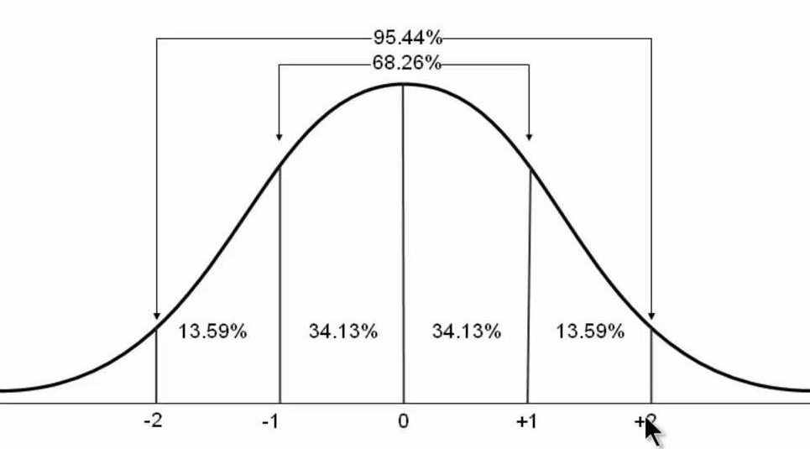
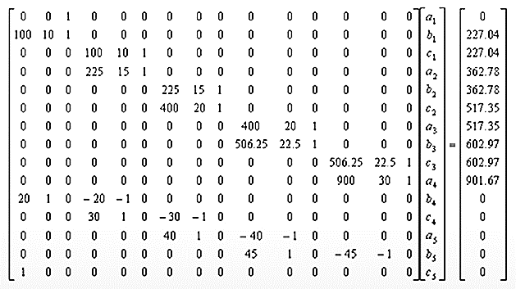
Approximations
Find solution of problem approximately because exact solution can not be find or not exist
Normal Distribution
1000 Simultaneous linear equation

Slide 4
Accuracy and Precision
Accuracy : It refers to how close a measurement is to the true value.
ISO says accurate measurement has no systematic error and no random error
Example: If the player always makes a basket, even though he strikes different portions of the rim.
Precision : Precision is how consistent results are when measurements are repeated. (it could have random error, observational error)
Example: If he doesn't make many baskets but always strikes the same portion of the rim, he has a high degree of precision.
ACcurate is Correct (or Close to real value)
PRecise is Repeating (or Repeatable)

Slide 5
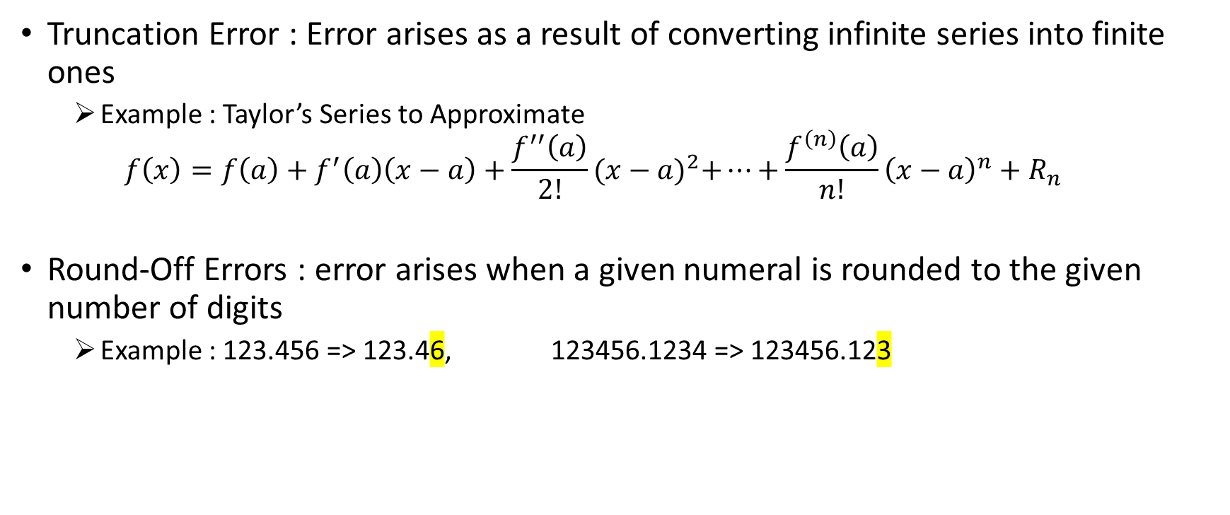
Truncation, Round-Off Errors
Truncation Error : Error arises as a result of converting infinite series into finite ones
Example : Taylor’s Series to Approximate
$$f\left(x\right)=f\left(a\right)+f^{′}\left(a\right)\left(x−a\right)+\frac{f^{′′}\left(a\right)}{2!}{(x−a)}^{2}+…+\frac{f^{\left(n\right)}\left(a\right)}{n!}{\left(x−a\right)}^{n}+R_{n}$$
Round-Off Errors : error arises when a given numeral is rounded to the given number of digits
Example : 123.456 => 123.46, 123456.1234 => 123456.123

Slide 6
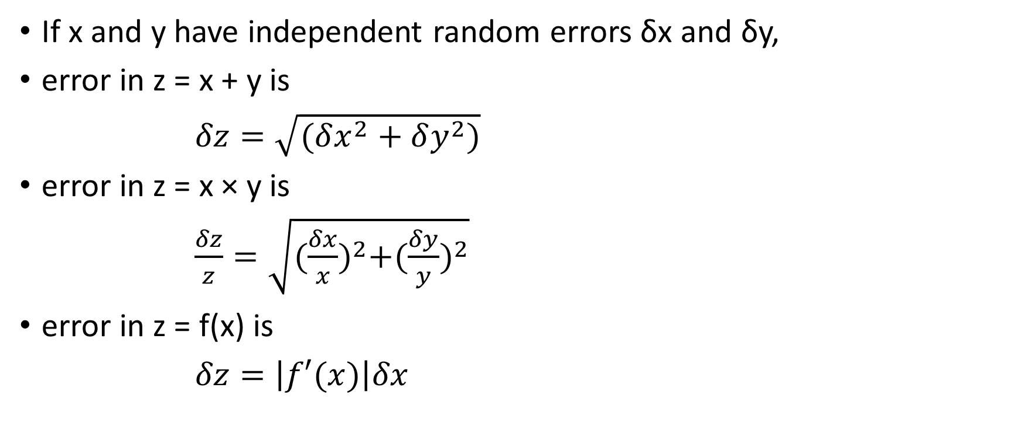
Propagation of Errors
If x and y have independent random errors δx and δy,
error in z = x + y is
$δz=\sqrt{(δx^{2}+δy^{2})}$
error in z = x × y is
$\frac{δz}{z}=\sqrt{{(\frac{δx}{x})}^{2}+({\frac{δy}{y})}^{2}}$
error in z = f(x) is
$δz=\left|f′(x)\right|δx$

Slide 7

Propagation of Errors - Example
Find a volume of a cube with side 2.00 ± 0.02 cm
V = S³
$δV=3S2δS=$ 3* 2*2*0.02= 0.24
So, V= 8 ± 0.2 cm3

Slide 8
Session 16
Roots of equations
Bracketing Methods
Open Methods
Roots of Polynomials
Conventional Methods
Muller's Method

Slide 9
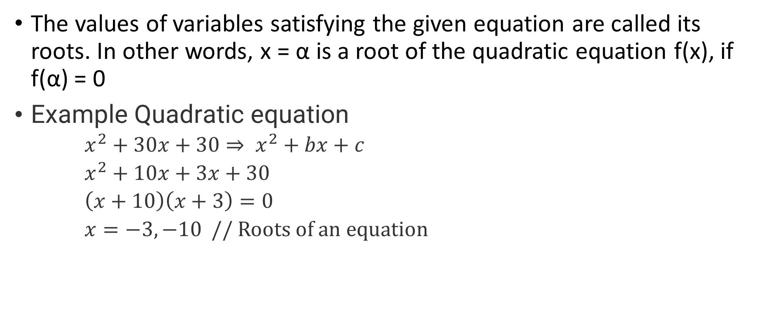
Roots of Equation
The values of variables satisfying the given equation are called its roots. In other words, x = α is a root of the quadratic equation f(x), if f(α) = 0
Example Quadratic equation
$x^{2}+30x+30⇒ x^{2}+bx+c$
$x^{2}+10x+3x+30$
$\left(x+10\right)\left(x+3\right)=0$
$x=−3,−10$ // Roots of an equation

Slide 10
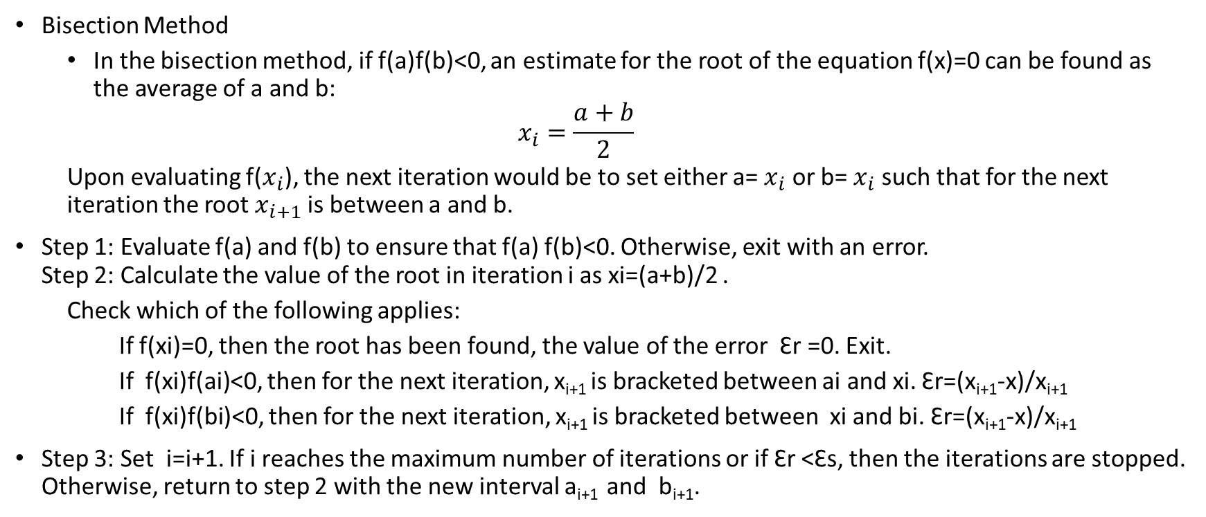
BRACKETING METHODS (Finding Roots of Equations)
Bisection Method
In the bisection method, if f(a)f(b)<0, an estimate for the root of the equation f(x)=0 can be found as the average of a and b:
$$x_{i}=\frac{a+b}{2}$$
Upon evaluating f($x_{i}$), the next iteration would be to set either a= $x_{i}$ or b= $x_{i}$ such that for the next iteration the root $x_{i+1}$is between a and b.
Step 1: Evaluate f(a) and f(b) to ensure that f(a) f(b)<0. Otherwise, exit with an error. Step 2: Calculate the value of the root in iteration i as xi=(a+b)/2 .
Check which of the following applies:
If f(xi)=0, then the root has been found, the value of the error Ꜫr =0. Exit.
If f(xi)f(ai)<0, then for the next iteration, x_{i+1} is bracketed between ai and xi. Ꜫr=(x_{i+1}-x)/x_{i+1}
If f(xi)f(bi)<0, then for the next iteration, x_{i+1} is bracketed between xi and bi. Ꜫr=(x_{i+1}-x)/x_{i+1}
Step 3: Set i=i+1. If i reaches the maximum number of iterations or if Ꜫr <Ꜫs, then the iterations are stopped. Otherwise, return to step 2 with the new interval a_{i+1} and b_{i+1}.

Slide 11
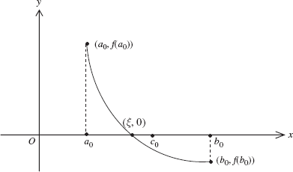
Bisection Method

Slide 12
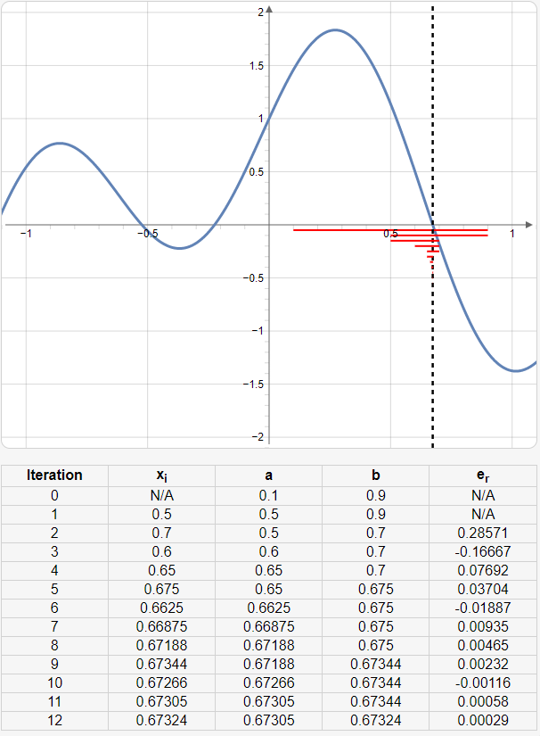
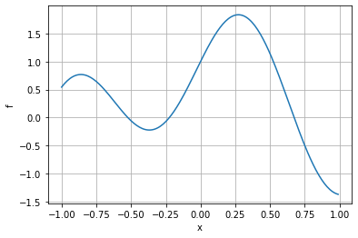

Bisection Method
Example:
$f\left(x\right)=\sin{5x}+cos2x$
a=-0.6, b=-0.5
a=-0.3, b=-0.2
a=0.1, b=0.9

Slide 13
Bisection Method - Lab
Open BRACKETING METHODS_Bisection.pdf

Slide 14
OPEN METHODS
Open methods do not rely on having the root squeezed between two values, but rather rely on an initial guess and then apply an iterative process to get better estimates for the root
faster in convergence if they converge, but they don’t always converge
for solving multiple nonlinear equations, open methods are easier to implement than bracketing methods which cannot be easily extended to multi-dimensions.
Fixed-Point Iteration Method,
Newton Raphson Method,
Secant Method

Slide 15
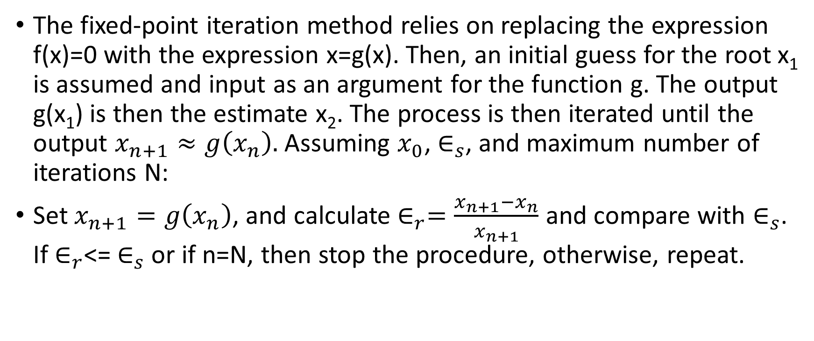
Fixed-Point Iteration Method
The fixed-point iteration method relies on replacing the expression f(x)=0 with the expression x=g(x). Then, an initial guess for the root x₁ is assumed and input as an argument for the function g. The output g(x₁) is then the estimate x₂. The process is then iterated until the output $x_{n+1}≈g\left(x_{n}\right).$Assuming $x_{0}$, $∈_{s}$, and maximum number of iterations N:
Set $x_{n+1}=g\left(x_{n}\right)$, and calculate $∈_{r}=\frac{x_{n+1}−x_{n}}{x_{n+1}}$ and compare with $∈_{s}$. If $∈_{r}$<= $∈_{s}$ or if n=N, then stop the procedure, otherwise, repeat.

Slide 16
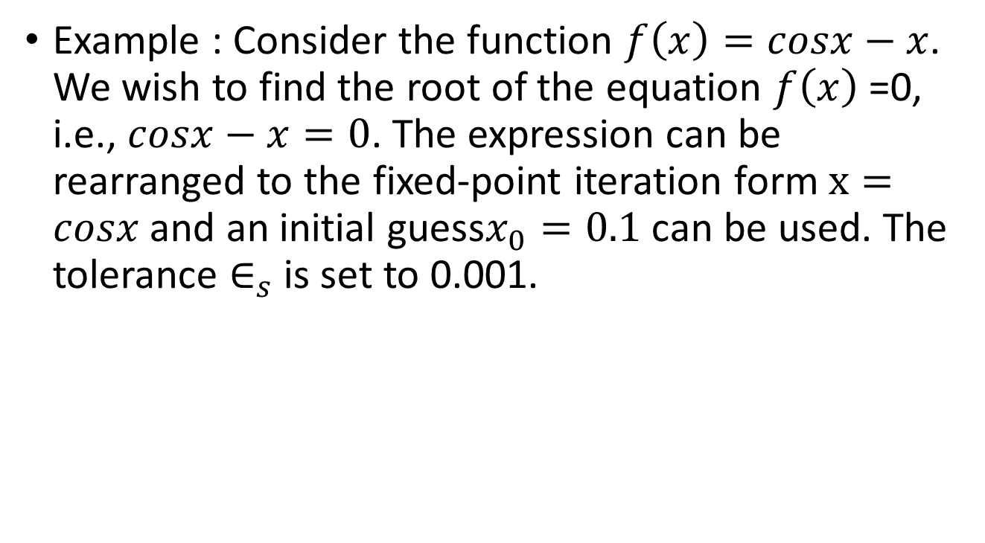
Fixed-Point Iteration Method
Example : Consider the function $f\left(x\right)=cosx−x$. We wish to find the root of the equation $f\left(x\right)$=0, i.e., $cosx−x=0$. The expression can be rearranged to the fixed-point iteration form $x=cosx$and an initial guess$x_{0}=0.1$can be used. The tolerance $∈_{s}$ is set to 0.001.
n | estimate | e_r
x0 | 0.1
x1 | 0.995004 | 0.899498
x2 | 0.544499 | -0.82737
x3 | 0.855387 | 0.363447
x4 | 0.655927 | -0.30409
x5 | 0.792483 | 0.172315
x6 | 0.702079 | -0.12877
x7 | 0.763501 | 0.080448
x8 | 0.72242 | -0.05687
x9 | 0.750208 | 0.037041
x10 | 0.731547 | -0.02551
x11 | 0.744142 | 0.016925
x12 | 0.735669 | -0.01152
x13 | 0.741382 | 0.007705
x14 | 0.737536 | -0.00521
x15 | 0.740128 | 0.003501
x16 | 0.738383 | -0.00236
x17 | 0.739558 | 0.00159
x18 | 0.738766 | -0.00107
x19 | 0.7393 | 0.000722

Slide 17
Roots of Polynomials
Roots of a polynomial refer to the values of a variable for which the given polynomial is equal to zero. If a is the root of the polynomial f(x), then f(a) = 0
Number of roots of any polynomial is depended on the degree of that polynomial. N=2, 2nd degree polynomial will have 2 roots

Slide 18
Muller’s Method
Muller Method is a root-finding algorithm for finding the root of a equation of the form, f(x)=0
It begins with three initial assumptions of the root, and then constructing a parabola through these three points, and takes the intersection of the x-axis with the parabola to be the next approximation. This process continues until a root with the desired level of accuracy is found .

Slide 19
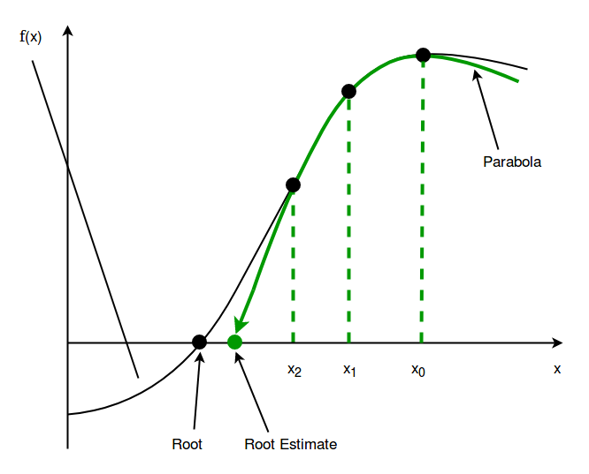
Muller’s Method : Algorithm
Assume any three distinct initial roots of the function, let it be x0, x1 and x2.
Now, draw a 2nd degree polynomial, i.e., a parabola, through the values of function f(x) for these points – x0, x1 and x2. The equation of the parabola, p(x) is
p(x)=c+b(x–x₂)+a(x–x₂)², where a, b, c –constants
After drawing the parabola, then find the intersection of this parabola with the x-axis, let us say x3
If x₃ is very close to x₂ within the permittable error, then x₃ becomes the root of f(x), otherwise, keep repeating the process of finding the next x₃ , with previous x₁ , x₂ and x₃ as the new x₀ , x₁ and x₂

Slide 20
Session 17
Linear Algebraic Equations
Gauss Elimination, Matrix Inversion, LU Decomposition
Regression, Linear Regression
Linear Least Squares
Nonlinear Regression, Interpolation
Newton’s Divided-Difference Interpolating Polynomials
Inverse Interpolation

Slide 21
Linear Algebraic Equations
Linear algebraic equations are equations of the first order.
Linear Equation | General Form | Example
Slope intercept form | y = mx + b | y + 2x = 3
Point–slope form | y – y₁ = m(x – x₁ ) | y – 3 = 6(x – 2)
General Form | Ax + By + C = 0 | 2x + 3y – 6 = 0
Intercept form | x/a + y/b = 1 | x/2 + y/3 = 1
As a Function | f(x) instead of y f(x) = x + C | f(x) = x + 3
The Identity Function | f(x) = x | f(x) = 3x
Constant Functions | f(x) = C | f(x) = 6

Slide 22
Linear Algebraic Equations - Lab
Using python plot all the form of “Linear Algebraic Equations”

Slide 23
Gauss elimination method
Gauss elimination method is used to solve a system of linear equations.
Gaussian elimination method is known as the row reduction algorithm for solving linear equations systems. It consists of a sequence of operations performed on the corresponding matrix of coefficients
Perform sequence of elementary row operations to transform the matrix till we get 0s (i.e., zeros) on the lower left-hand corner of the matrix as much as possible.
elementary row operations:
Swapping two rows: R2 ↔ R3
Multiplying a row : R1 → kR2 ; k<>0
Adding a multiple of one row to another row : R2 → R2 + 3R1

Slide 24
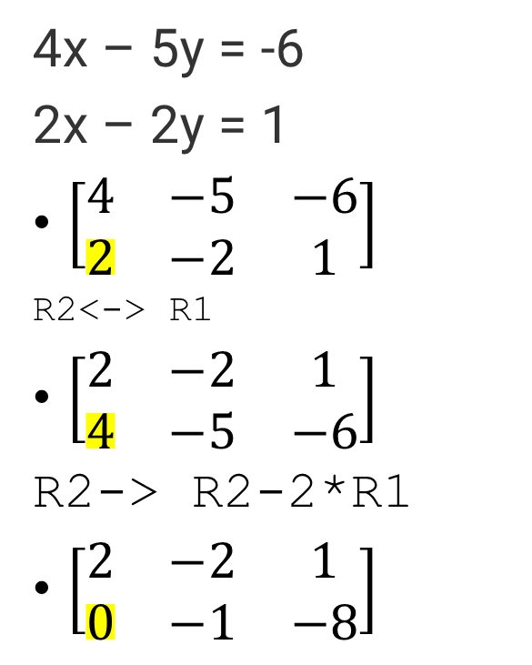
Gauss elimination method
4x – 5y = -6
2x – 2y = 1
$\left[\begin{matrix}4 & −5 & −6 \\ 2 & −2 & 1\end{matrix}\right]$
R2<-> R1
$\left[\begin{matrix}2 & −2 & 1 \\ 4 & −5 & −6\end{matrix}\right]$
R2-> R2-2*R1
$\left[\begin{matrix}2 & −2 & 1 \\ 0 & −1 & −8\end{matrix}\right]$
2x-2y=1 ; -y=-8=>y=8
2x-2*8=1
2x=17
x=8.5

Slide 25
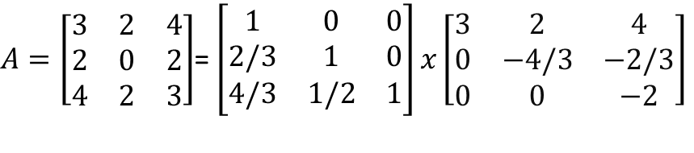
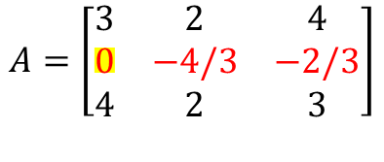
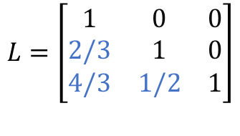
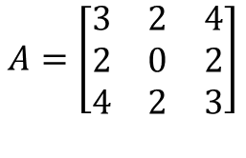
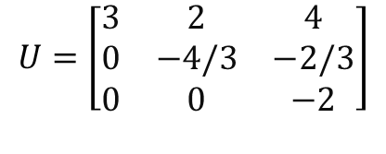
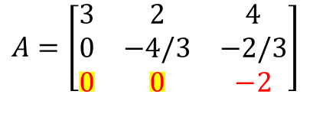
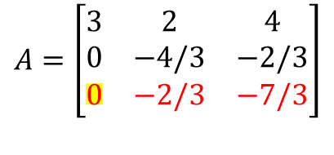
Gauss elimination and LU decomposition
$$A=\left[\begin{matrix}3 & 2 & 4 \\ 2 & 0 & 2 \\ 4 & 2 & 3\end{matrix}\right]$$
R2←R2-(2/3)×R1 [L_{2,1}=2/3]
LU decomposition for A is
$A=\left[\begin{matrix}3 & 2 & 4 \\ 2 & 0 & 2 \\ 4 & 2 & 3\end{matrix}\right]$= $\left[\begin{matrix}1 & 0 & 0 \\ 2/3 & 1 & 0 \\ 4/3 & 1/2 & 1\end{matrix}\right]x\left[\begin{matrix}3 & 2 & 4 \\ 0 & −4/3 & −2/3 \\ 0 & 0 & −2\end{matrix}\right]$
$$A=\left[\begin{matrix}3 & 2 & 4 \\ 0 & −4/3 & −2/3 \\ 4 & 2 & 3\end{matrix}\right]$$
R3←R3-(4/3)×R1 [∴L_{3,1}=4/3]
$$A=\left[\begin{matrix}3 & 2 & 4 \\ 0 & −4/3 & −2/3 \\ 0 & −2/3 & −7/3\end{matrix}\right]$$
R3←R3-(1/2)×R2 [∴L_{3,2}=1/2]
LU
$$A=\left[\begin{matrix}3 & 2 & 4 \\ 0 & −4/3 & −2/3 \\ 0 & 0 & −2\end{matrix}\right]$$
$$U=\left[\begin{matrix}3 & 2 & 4 \\ 0 & −4/3 & −2/3 \\ 0 & 0 & −2\end{matrix}\right]$$
$$L=\left[\begin{matrix}1 & 0 & 0 \\ 2/3 & 1 & 0 \\ 4/3 & 1/2 & 1\end{matrix}\right]$$

Slide 26
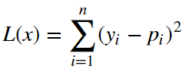
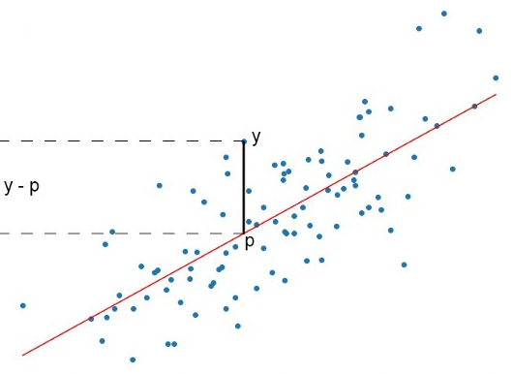
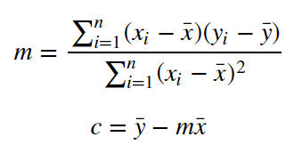
Linear Regression using Least Squares Error
Quadratic Loss Function
Least Squares method loss function
(partial derivative of L, equating it to 0 and then finding an expression for m and c)
x̅ is the mean of all the values in the input X
ȳ is the mean of all the values in the output Y
m = slop of predicted line
c = y intercept of predicted line

Slide 27
Lab: Linear Regression using Least Squares Error
Session 17_Lab_Linear Regression using Least Squares.pdf

Slide 28
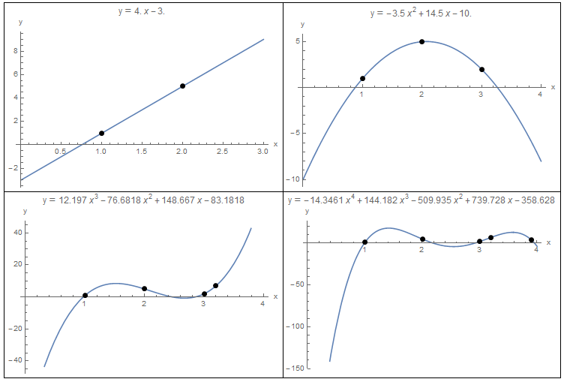
Nonlinear Regression, Interpolation
Polynomial interpolation is the procedure of fitting a polynomial of degree n to a set of n+1 data points
Polynomial interpolation relies on the fact that for every n+1 data points, there is a unique polynomial of degree n that passes through these n+1 data points

Slide 29
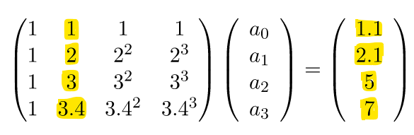

Lab - Interpolation
Find polynomial that would fit the data points (1,1.1), (2,2.1), (3,5), (3.4,7)
There are four data points, so, we can fit a 3rd degree polynomial
Session 17_Lab_Polynomial interpolation.pdf
$MA=Y⇒A=Y∗M′$

Slide 30
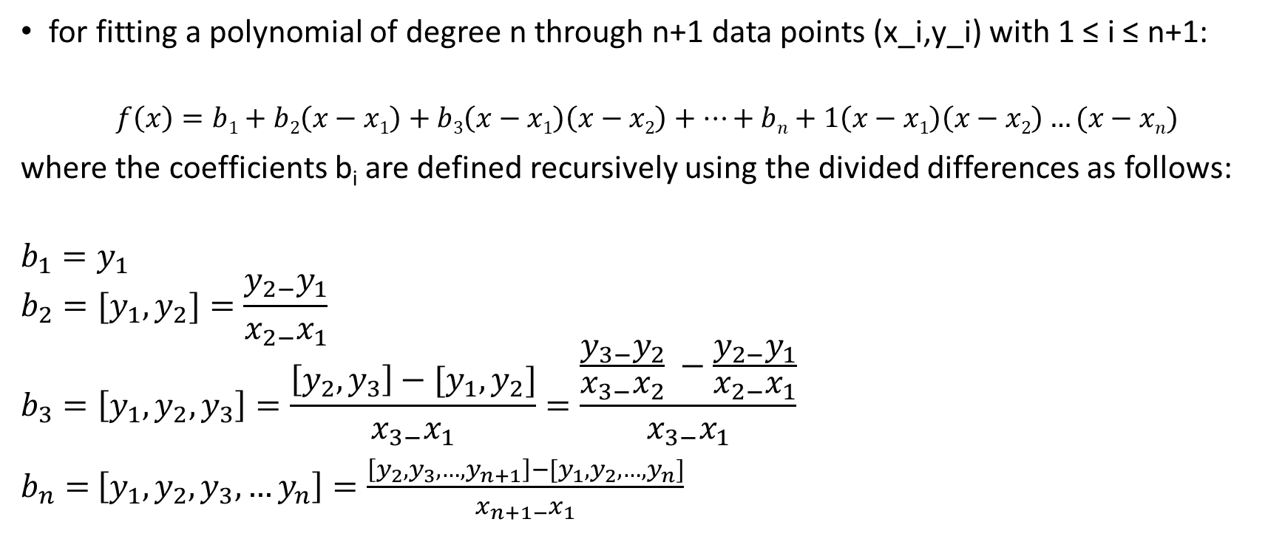
Newton Interpolating Polynomials
for fitting a polynomial of degree n through n+1 data points (x_i,y_i) with 1 ≤ i ≤ n+1:
$$f\left(x\right)=b1+b2\left(x−x1\right)+b3\left(x−x1\right)\left(x−x2\right)+…+bn+1\left(x−x1\right)\left(x−x2\right)…(x−xn)$$
where the coefficients b_{i} are defined recursively using the divided differences as follows:
$$b_{1}=y_{1}$$
$$b_{2}=[y_{1},y_{2}]=\frac{y_{2−}y_{1}}{x_{2−}x_{1}}$$
$$b_{3}=\left[y_{1},y_{2},y_{3}\right]=\frac{\left[y_{2},y_{3}\right]−[y_{1},y_{2}]}{x_{3−}x_{1}}=\frac{\frac{y_{3−}y_{2}}{x_{3−}x_{2}} −\frac{y_{2−}y_{1}}{x_{2−}x_{1}}}{x_{3−}x_{1}}$$
$b_{n}=$ $\left[y_{1},y_{2},y_{3},…y_{n}\right]=\frac{\left[y_{2},y_{3},…,y_{n+1}\right]−[y_{1},y_{2},…,y_{n}]}{x_{n+1−}x_{1}}$

Slide 31
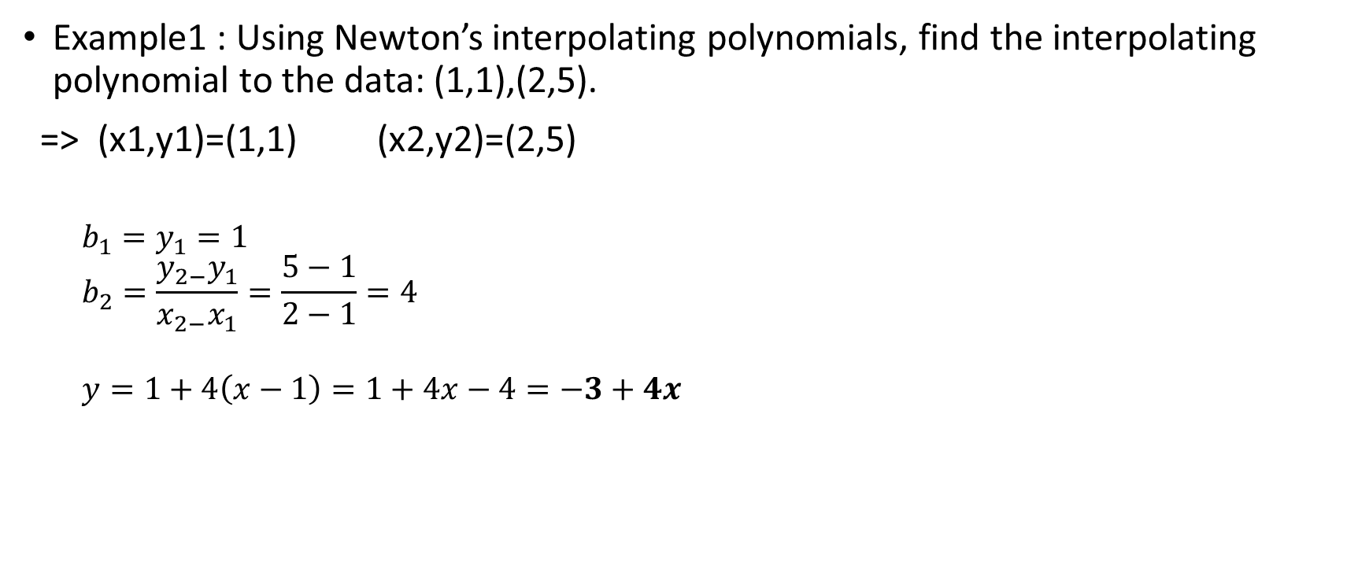
Newton Interpolating Polynomials
Example1 : Using Newton’s interpolating polynomials, find the interpolating polynomial to the data: (1,1),(2,5).
=> (x1,y1)=(1,1) (x2,y2)=(2,5)
$$b_{1}=y_{1}=1$$
$$b_{2}=\frac{y_{2−}y_{1}}{x_{2−}x_{1}}=\frac{5−1}{2−1}=4$$
$$y=1+4\left(x−1\right)=1+4x−4=−3+4x$$

Slide 32
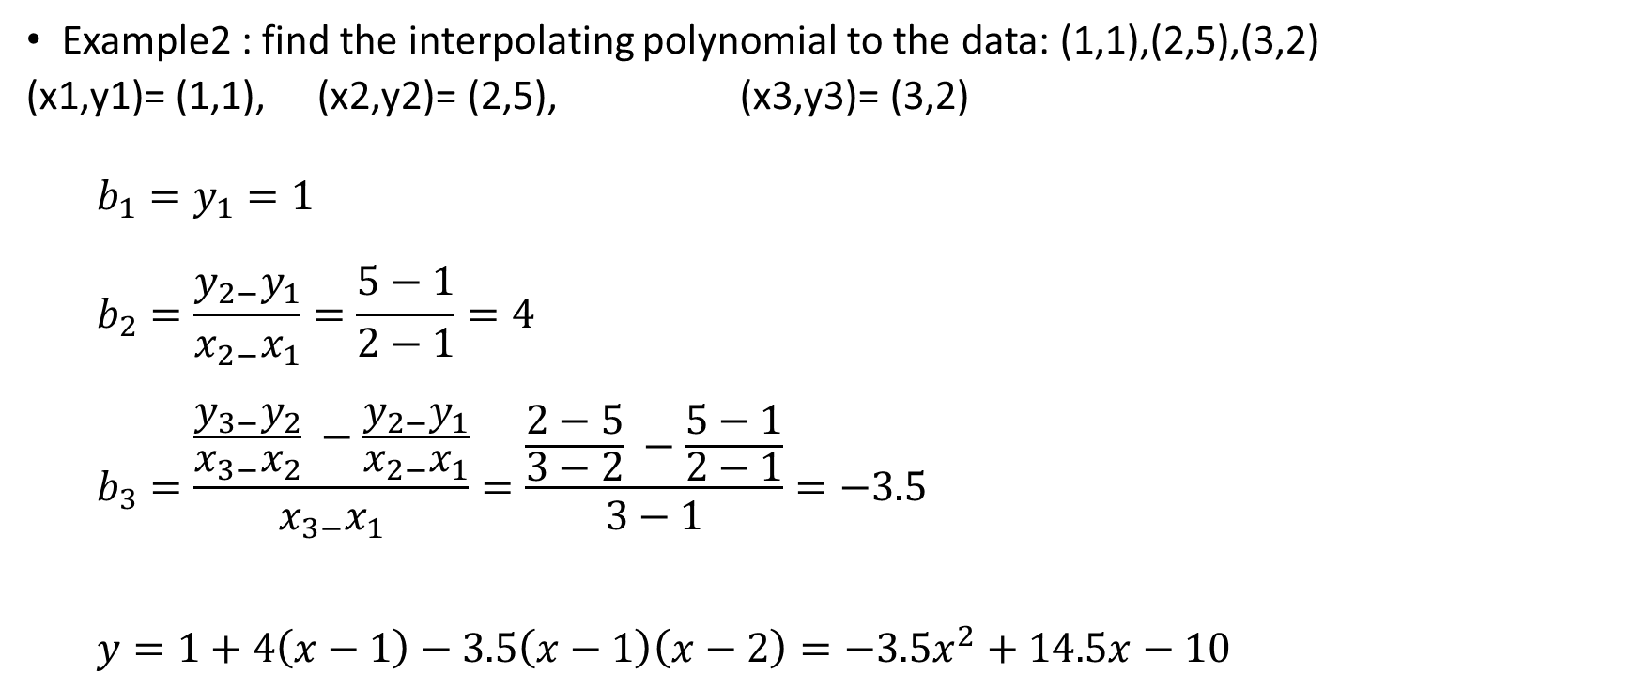
Newton Interpolating Polynomials
Example2 : find the interpolating polynomial to the data: (1,1),(2,5),(3,2)
(x1,y1)= (1,1), (x2,y2)= (2,5), (x3,y3)= (3,2)
$$b_{1}=y_{1}=1$$
$$b_{2}=\frac{y_{2−}y_{1}}{x_{2−}x_{1}}=\frac{5−1}{2−1}=4$$
$$b_{3}=\frac{\frac{y_{3−}y_{2}}{x_{3−}x_{2}} −\frac{y_{2−}y_{1}}{x_{2−}x_{1}}}{x_{3−}x_{1}}=\frac{\frac{2−5}{3−2} −\frac{5−1}{2−1}}{3−1}=−3.5$$
$$y=1+4\left(x−1\right)−3.5\left(x−1\right)\left(x−2\right)=−3.5x^{2}+14.5x−10$$

Slide 33
Inverse Interpolation
It is defined as the process of finding the value of the argument corresponding to a given value of the function lying between two tabulated functional values
Lagrange’s inverse interpolation formula
Successive approximation method or iteration method
Reversion of series method

Slide 34
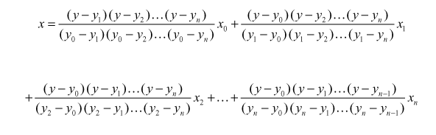

Lagrange’s Inverse Interpolation Formula
Given a set of values $\left(x_{1},y_{1}\right),\left(x_{2},y_{2}\right),…,(x_{n},y_{n})$ treating y as the independent variable and x as the dependent variable
Formula

